Slide 1
Object-Oriented Programming
WEEK 09 Abeeha Sattar

Slide 2
Operator Overloading
In C++ we have the ability to redefine how the operators interact with a specific class.
We can provide the operators with a special meaning for a given datatype.
This is operator overloading

Slide 3
Operator Overloading
For example, we can overload an operator ‘+’ in a class like string so that we can concatenate two strings by just using +
Other example classes where arithmetic operators may be overloaded are Complex Numbers, Fractional Numbers, Big Integers, etc.

Slide 4
How to Overload Operators
Overloaded operators are functions with special names: the keyword "operator" followed by the symbol for the operator being defined
className operator operatorSymbol (className obj2ndParam) {
//do something
return classNameTypeObjHoldingtheResult;
}
Note: This is only for binary operators.

Slide 5
Example
class ComplexNumber {
int real, imaginary;
public:
ComplexNumber(int r = 0, int i = 0) {
real = r;
imaginary = i;
}
ComplexNumber operator + (ComplexNumber const &obj) {
ComplexNumber result;
result.real = real + obj.real;
result.imaginary = imaginary + obj.imaginary;
return result;
}
};
Notes:
Main:
ComplexNumber c1(1, 2), c2(6, 7);
ComplexNumber c3 = c1 + c2;

Slide 6
For Unary Operators
//pre-operator
ComplexNumber operator ++ () {
real++;
}
//post-operator
ComplexNumber operator ++ (int) {
real++;
}
Notes:
ComplexNumber c1(1, 2), c2(6, 7);
ComplexNumber c3 = c1 + c2;
c3++;
++c3;

Slide 7
More Operator Overloading after this…
FRIEND FUNCTIONS

Slide 8
Friend Functions
A friend function of a class is defined outside that class’ scope but it has the right to access all private and protected members of the class.
Even though the prototypes for friend functions appear in the class definition, friends are not member functions.

Slide 9
How to: Friend Function
To declare a function as a friend of a class, precede the function prototype in the class definition with keyword friend as follows
class someClass {
//some vars
public:
//some functions
friend void someFunction(); //friend function signature
}
void someFunction {
someClass variable;
variable.privateMember = “can access!!”;
}

Slide 10
Example:
class AnyClass {
int anyInt;
string anyString;
void display() {
cout << anyInt << " " << anyString << endl;
}
//friend function declarations
friend void setDefaults();
friend void setSpecific(AnyClass anyObj, int aInt, string aString);
};

Slide 11
Example:
//this doesn’t really do anything
void setDefaults() {
AnyClass anyObj;
anyObj.anyInt = 999;
anyObj.anyString = "ffffff";
}
//this doesn’t really do anything still, but will, if we change the object to an object reference
void setSpecific(AnyClass anyObj, int aInt, string aString) {
anyObj.anyInt = aInt;
anyObj.anyString = aString;
anyObj.display();
}

Slide 12
Example:
int main()
{
AnyClass obj;
setDefaults();
setSpecific(obj, 99, "abcde");
}

Slide 13
Now back to…
OPERATOR OVERLOADING

Slide 14
Globally Overloading Operators using Friend Functions
class ComplexNumber {
int real, imaginary;
public:
ComplexNumber(int r = 0, int i = 0) {
real = r;
imaginary = i;
}
ComplexNumber operator + (ComplexNumber const &obj) {
ComplexNumber result;
result.real = real + obj.real;
result.imaginary = imaginary + obj.imaginary;
return result;
}
//declaration of friend function
friend ComplexNumber operator - (ComplexNumber const& obj1, ComplexNumber const& obj2);
//pre-operator
ComplexNumber operator ++ () {
real++;
}
//post-operator
ComplexNumber operator ++ (int) {
real++;
}
};

Slide 15
Implementation of Friend Function
ComplexNumber operator - (ComplexNumber const& obj1, ComplexNumber const& obj2) {
ComplexNumber result;
result.real = obj1.real - obj2.real;
result.imaginary = obj1.imaginary - obj2.imaginary;
return result;
}

Slide 16
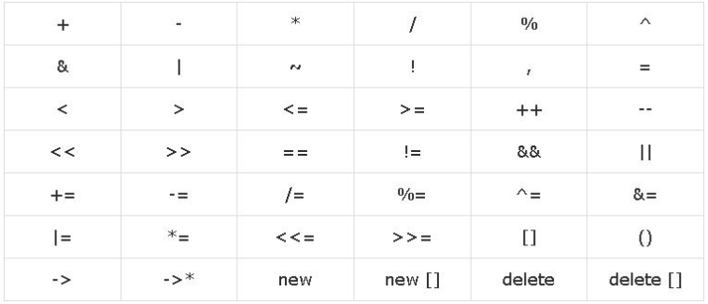
Overloadable Operators

Slide 17

Non-Overloadable Operators

Slide 18
Difference between Member and Friend Function in Operator Overloading
Member function:
The number of parameters to be passed is reduced by one, as the calling object is implicitly supplied is an operand.
Unary operators takes no explicit parameters.
Binary operators take only one explicit parameter.
Friend Function:
More parameters can be passed.
Unary operators take one explicit parameter.
Binary operators take two explicit parameters.
Notes:
https://www.mygreatlearning.com/blog/operator-overloading-in-cpp/

Slide 19
Fin.
: )

